Slide 1
Eurogas
Accelerating the transition to climate neutrality through dialogue and advocacy on optimising the use of gases.
https://eurogas.org/

Slide 2
About Eurogas
Eurogas is an association of 101 companies and associations across 28 countries, spanning the length of the gas value chain.
Our members cover gas wholesale and retail gas markets, and the distribution of natural gas, biomethane and hydrogen. We also work with companies active on gases for vehicles, and on value chain methane emissions management.
Eurogas accelerates the transition to carbon neutrality through dialogue and advocacy about optimising the use of gas and gaseous fuels.

Slide 3




































































































Slide 4
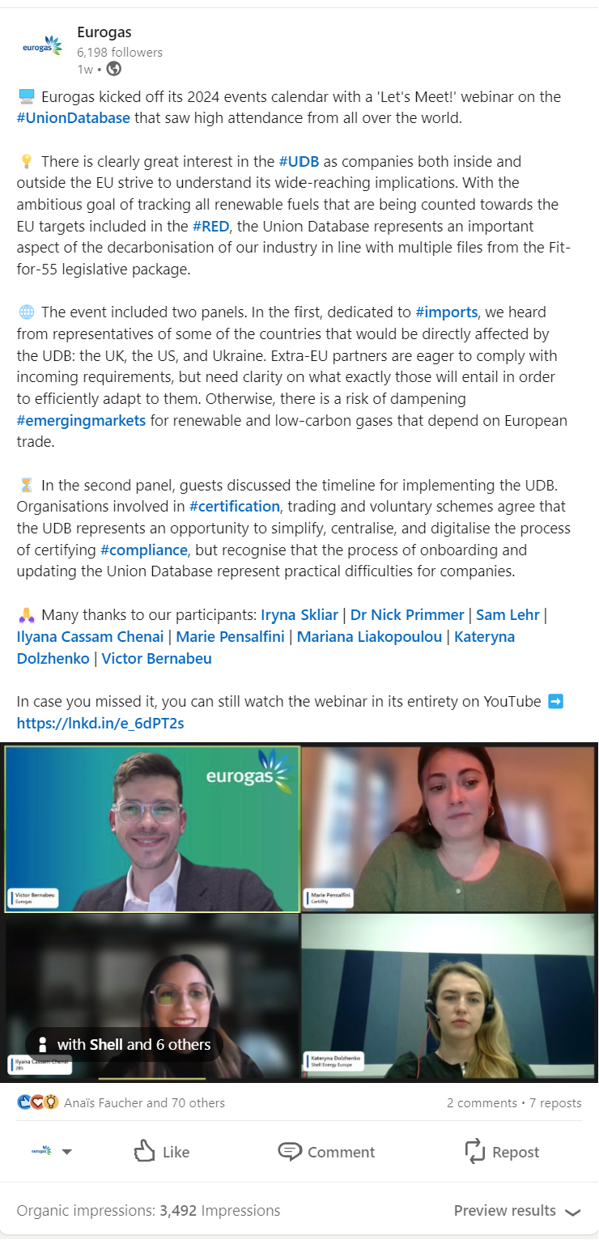
Our objectives
Helping to improve knowledge of gases and their use in Europe, including its performance and benefits.
Supporting information exchange on gas issues of general interest with stakeholders.
Promoting the development of gaseous fuels and feedstock through studies in legal, economic, technical and scientific fields.
Promoting the smooth functioning of the internal gas market and, within its field of competence, any activity that may contribute to sustainable development in Europe.
Taking positions on relevant EU legislative and political issues vis-à-vis European institutions and other stakeholders.

Slide 5
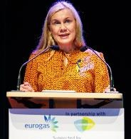
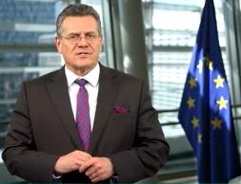
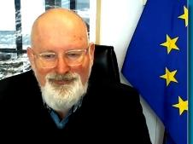
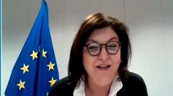
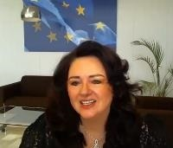
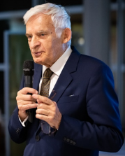
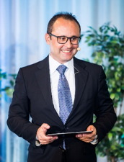
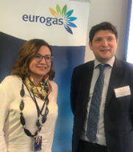
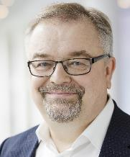
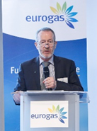
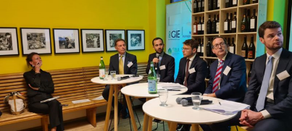
Effective engagement
European Commissioners & high-level Commission officials
Kadri Simson
EC Commissioner
for Energy
Maroš Šefčovič
EC Executive Vice-President
Frans Timmermans,
Former EC Executive VP
Adina Vălean
EC Commissioner
for Transport
Helena Dalli
EC Commissioner
for Equality
Ditte Juul Jørgensen
Director General, DG ENER
Members of the European Parliament
MEP Jerzy Buzek
MEP Cristian S. Buşoi
MEP Maria Spyraki
MEP Jens Geier
MEP Sean Kelly
MEPs Nagtegaal & Katainen
Plus National Government Officials, and many more!

Slide 6


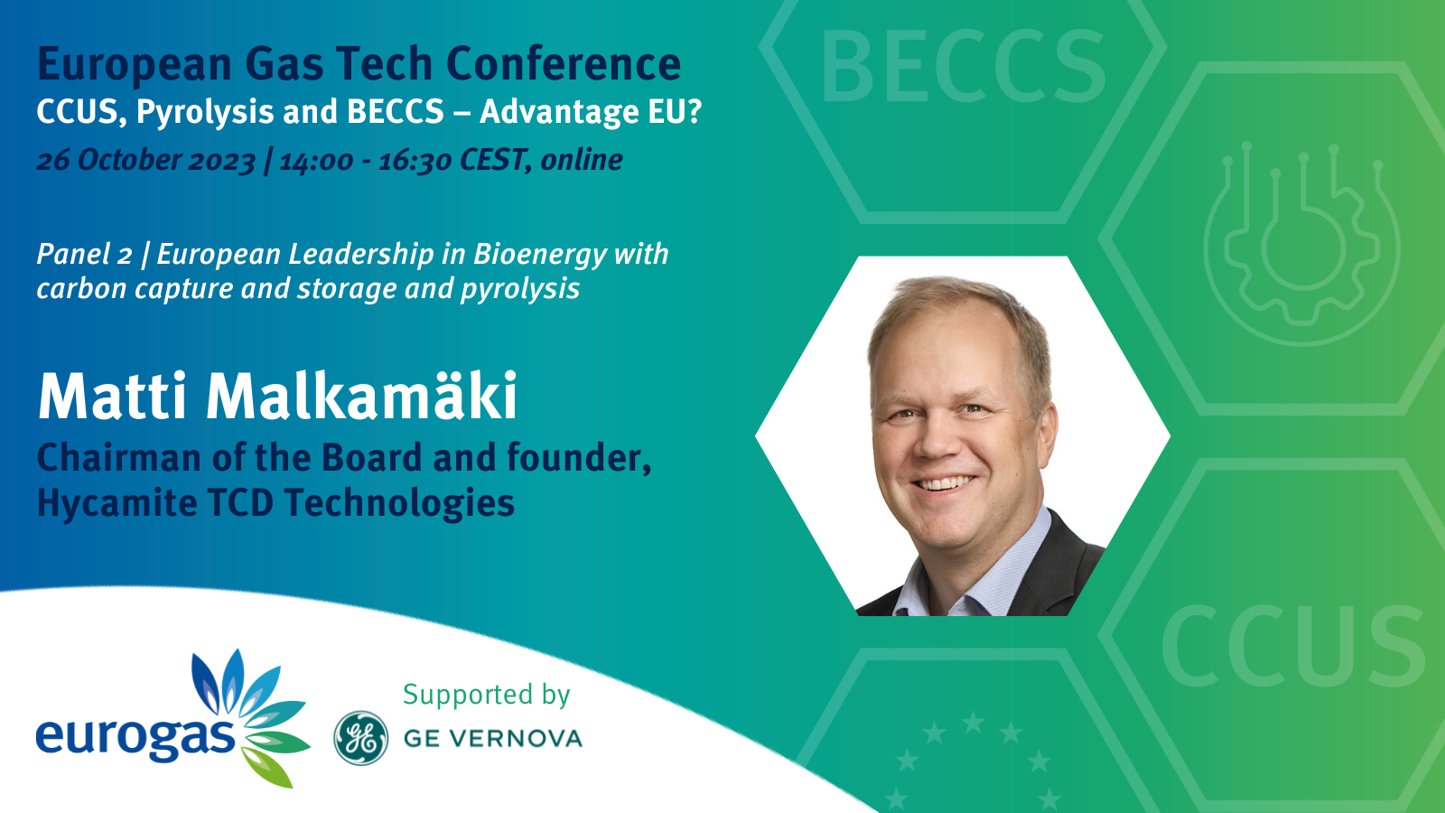
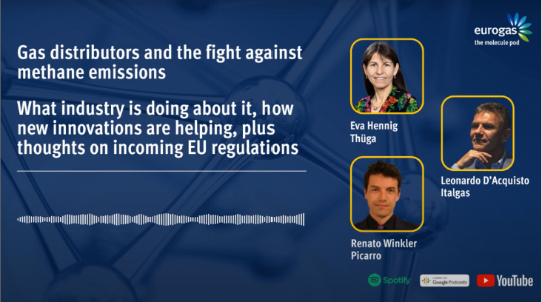
Visibility for our members

Slide 7
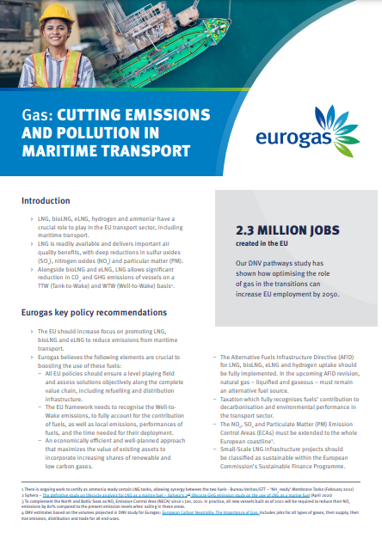
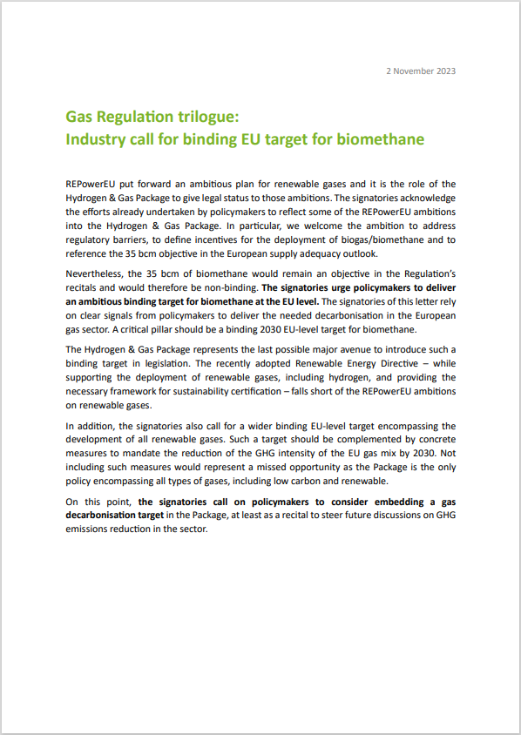
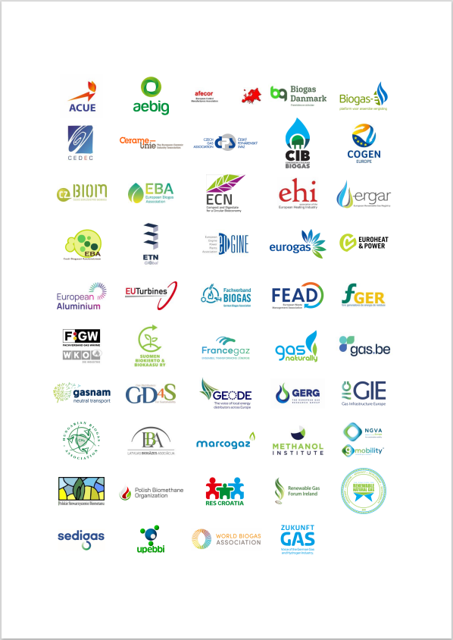
Recent publications

Slide 8
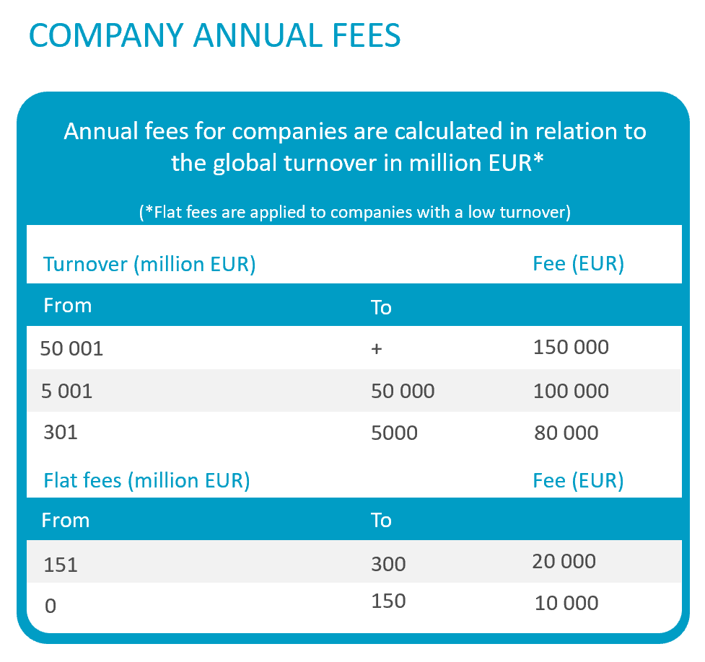
Membership categories
Category I: Full Membership for Companies
Full Membership sub-categories for Companies
Consisting of companies or undertakings having a direct link with the gas supply market and meeting all the following conditions:
they have their main decision-making centre in the territory of one of the present or past Member States of the EU or in the territory of one of the present or past Member States of the EFTA;
they support the objectives and activities of the Association;
they engage in a significant manner in the European gas market in one or more of the following activities: supply, trading, distribution, transport, and their related activities such as storage and LNG;
they are approved as a Full Member by the Board of Directors.

Slide 9
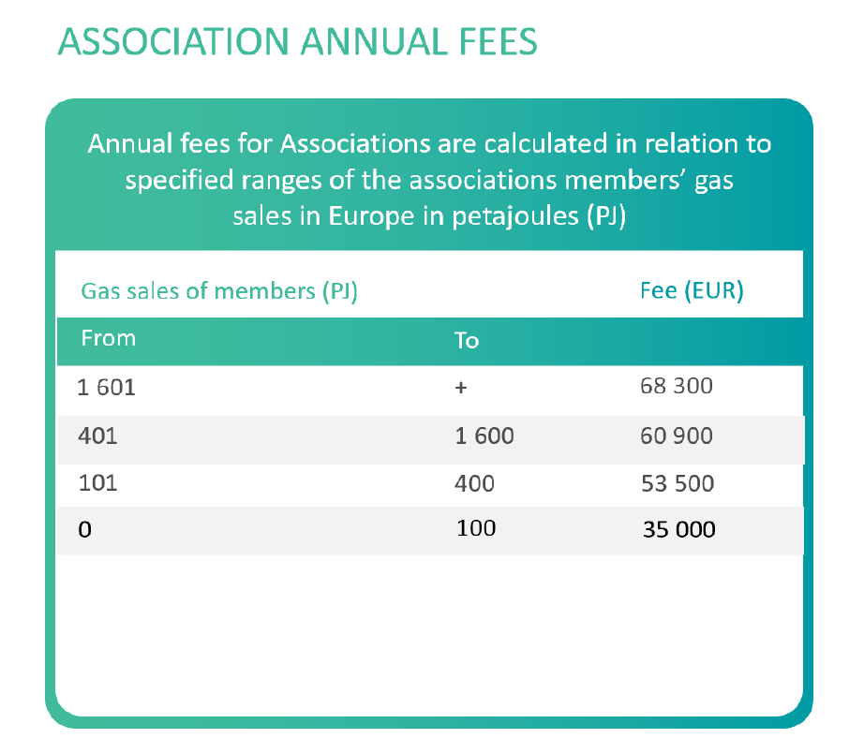
Membership categories
Category II: Full Membership for Associations
Full Membership sub-categories for Associations
Consisting of federations and associations at national level, which:
Represent the gas industry or part thereof in one of the present or past Member States of the EU or of the EFTA
Support the objectives and activities of the Association
Are approved as a Full Member by the Board of Directors;
Category II Members pay an annual subscription between EUR 35,000 and 68,300 and each have one vote.

Slide 10
Membership categories
Category III: Full Membership for DSOs
Category IV: Associate Membership
Distribution system operators may apply for Full Membership provided that they respect the Association's policies and decisions on the unbundling regime.
Otherwise, Distribution members can pay a reduced fee to become an associate member. Such members pay an annual subscription of minimum EUR 10,000 and do not have the right to vote at the General Assembly.
Associate Membership is open to:
(i) companies and associations engaged solely in distribution activities and which support the objectives of the Association and which are approved as an Associate Member by the Board of Directors, and
(ii) associations, companies and federations which do not fulfill the conditions to become a Full Member but which are in other ways direct participants of the gas value chain, and which support the objectives of the Association, and which are approved as an Associate Member by the Board of Directors;
Associate Members pay an annual subscription of EUR 10,000 (EU/UK/EFTA) or EUR 15,000 (non-EU/UK/EFTA) and do not have the right to vote in the General Assembly.

Slide 11
Membership Categories
Category V: Associate Membership – Transport Division
Open to companies and associations engaged solely in transport activities, and which support the objectives of the Association, and which are approved as an Associate Member by the Board of Directors;
Transport Associate Members pay an annual subscription of EUR 5,000 and may attend the Transport and Advocacy Committees only. They do not have the right to vote in the General Assembly.

Slide 12
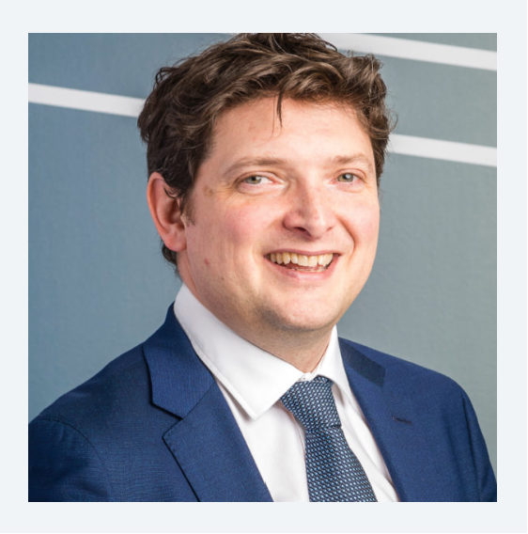


Contact us
James Watson
Secretary General
james.watson@eurogas.org
Victor Bernabeu
Director, Policy
victor.bernabeu@eurogas.org
Martina Bassan
Senior Advisor, Communications
martina.bassan@eurogas.org

Slide 13
Thank you

